Slide 1

Online Job Portal
Jash Patel
(202006100110116)
Kalash Saha
(202006100110040)

Slide 2

Definition
In today's rapidly evolving job market, job seekers, employers, and recruiters face a range of challenges that hinder efficient job matching and recruitment processes. These challenges include:
Limited Access to Opportunities
Time-Consuming Application Process
Inefficient Recruitment Process
Lack of Transparency
Scarcity of Niche Opportunities
Geographical Constraints
Mobile Accessibility
In response to these challenges, the development of a comprehensive online job portal seeks to create a solution that benefits job seekers, employers, and recruiters alike. Such a portal aims to streamline the job search and hiring processes, enhance transparency, improve data-driven decision-making, and promote inclusivity while offering a user-friendly and accessible platform.

Slide 3



Scope
The Scope of this System will be within India only.

Slide 4
Functional Requirements
RN | Description | Comments
FR1 | System shall provide a Form to a new user to register themselves with the system by submitting below mentioned information. Name, age, contact no, address , email, password | User Registration
FR2 | Enable a registered user to manage their own profile which includes address, contact no, password etc. | Manage User Profile
FR3 | System shall authenticate and login users into the system. | User Login
FR4 | System shall Enable a registered user to change password if user forgets password. System shall Send OTP through mail for user’s verification. | Forgot password and Change Password
FR5 | System shall allow Users to update information, change profile photo, delete profile, etc | Manage Profile
FR6 | System shall provide Job Seekers to apply for Jobs. | Apply for job

Slide 5
Cont.
RN | Description | Comments
FR7 | System will allow job providers to post jobs. | Post Jobs
FR8 | System shall allow job providers to view job applications and manage them and also download them. | Manage Applications
FR9 | System shall send notifications to the users as per their respective events. | Notifications
FR10 | System shall show recommended jobs to the Job Seekers according to their profiles. | Job Recommandations
FR11 | System will allow the job provider to record the following details of the jobs such as... job role, job category, job criteria, job type, job time, salary, address, etc. System shall allow the job provider to update and delete jobs too. | Manage Jobs
FR12 | System shall Validate the date for the job. After the deadline expires, the job seeker will not be able to see that job. | Validate job date and set deadline

Slide 6
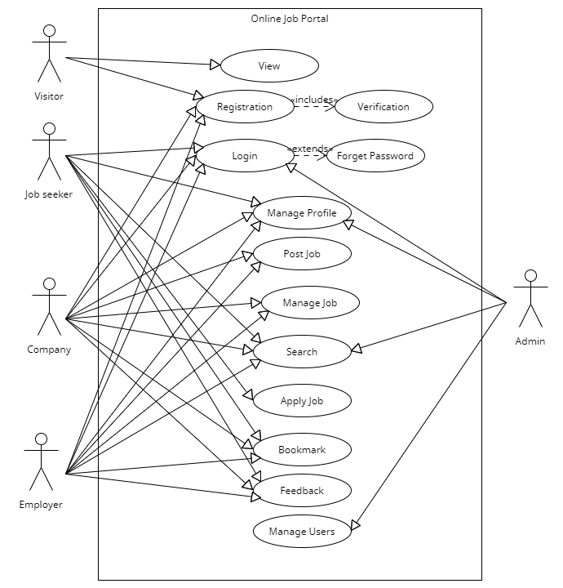
Use case Diagram

Slide 7
Database Schema
tbl_user { userId[PK], firstName, lastName, email, gender, password, number, address, userType }
tbl_job { jobId[PK], jobRole,userId[FK] jobType, vacancy, category, salary, jobTiming, description, jobCriteria, status, startdate, endDate, hired }
FD: userId-> firstName, lastName, email, password, number, address
tbl_jobSeeker{ userId[FK], resume, skillId[FK], status, history }
FD: userId-> firstName, lastName, email,gender, password, number, address
FD: skillId -> skillName
tbl_jobProvider {userId[FK],companyId[FK]}
FD: userId-> firstName, lastName, email, password, number, address

Slide 8
tbl_company { coId[PK], userId[FK], estDate, category }
FD: userId-> firstName, lastName, email, password, number, address
tbl_jobApplication{ AppId[PK], userId[FK],jobId[FK], Status }
FD: userId-> firstName, lastName, email, password, number, address
FD: jobId -> jobRole,userId, jobType, vacancy, category, salary, jobTiming, description, jobCriteria, status, startdate, endDate

Slide 9

Thank You

